Slide 1
All about Blockchain Interoperability
Yu Wang

Slide 2
Overview
Overview of Blockchain Interoperability Approaches

Slide 3
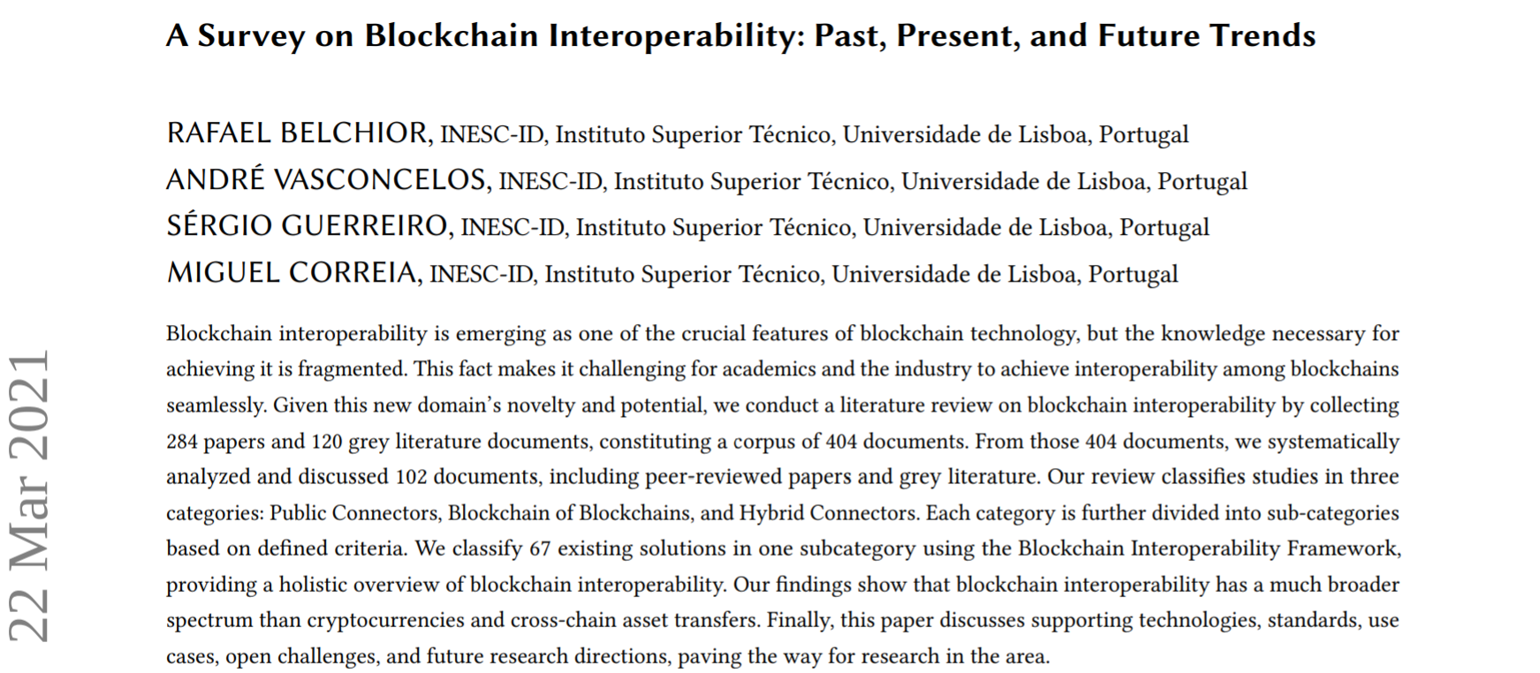
Sepcial thanks for this paper

Slide 4
Public Connectors ‧ Blockchain of Blockchains ‧ Hybird connectors
How to do this?
BTC ETH
State1 10 0
State2 0 10
Sidechain
Notary schemes
Hashed time-lock connectors
Overview

Slide 5
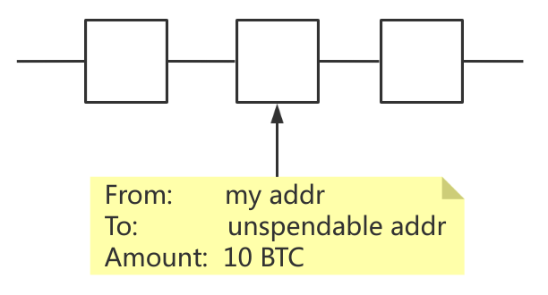
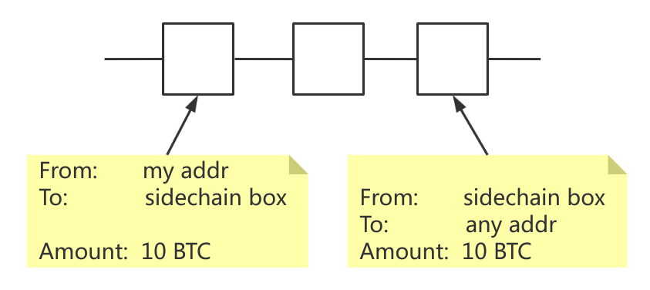
Public Connectors ‧ Blockchain of Blockchains ‧ Hybird connectors
one-way peg
two-way peg
Sidechain
Notary schemes
Hashed time-lock connectors
Overview

Slide 6
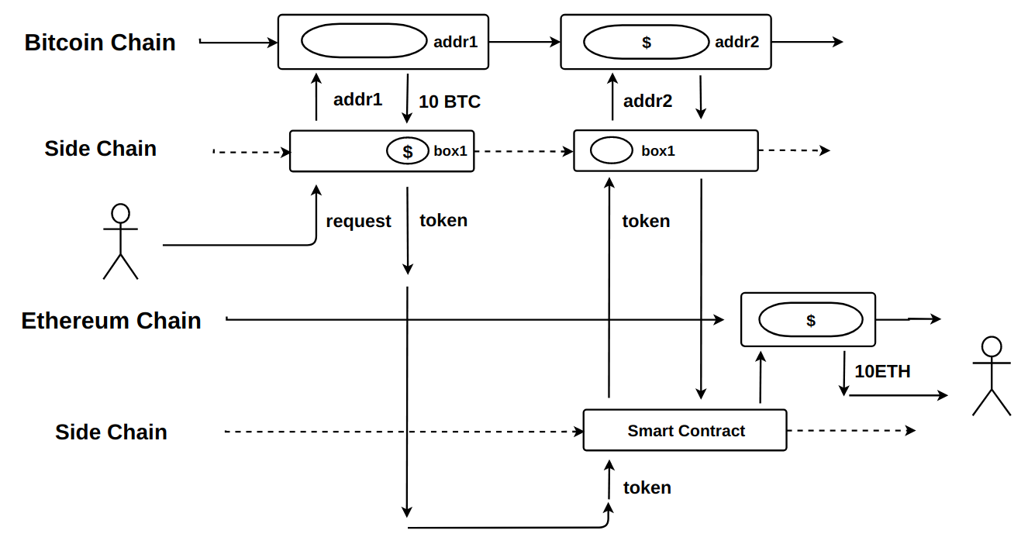
Public Connectors ‧ Blockchain of Blockchains ‧ Hybird connectors
Maybe like this:
Sidechain
Notary schemes
Hashed time-lock connectors
Overview

Slide 7







Public Connectors ‧ Blockchain of Blockchains ‧ Hybird connectors
Sidechain
Notary schemes
Hashed time-lock connectors
Overview

Slide 8
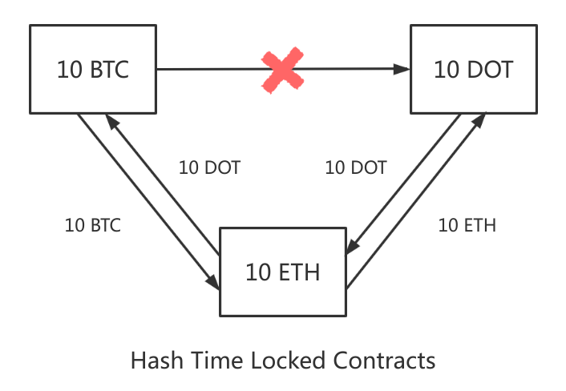
Public Connectors ‧ Blockchain of Blockchains ‧ Hybird connectors
Sidechain
Notary schemes
Hashed time-lock connectors
Overview

Slide 9
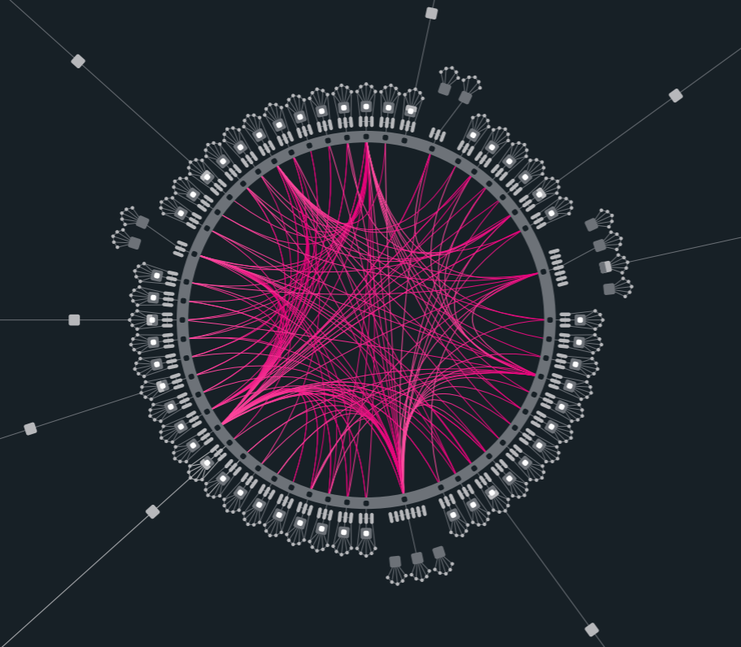
Pulic Connectors ‧ Blockchain of Blockchains ‧ Hybird connectors
Overview

Slide 10


Pulic Connectors ‧ Blockchain of Blockchains ‧ Hybird connectors
???
Trusted relays
Blockchain-agnostic protocols
Blockchain migrators
Overview

Slide 11
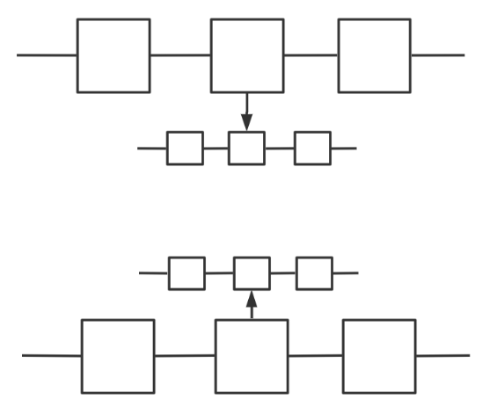
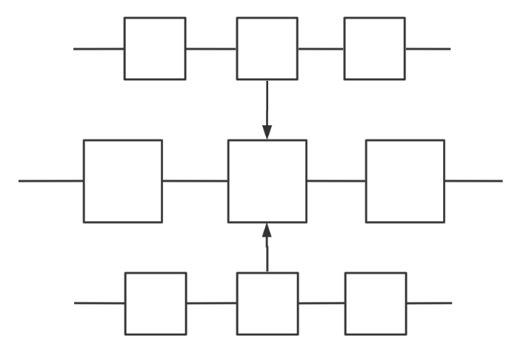
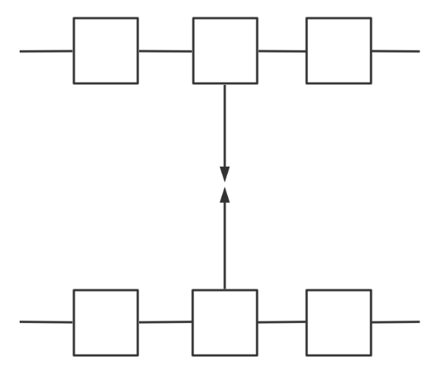
Public Connectors vs Blockchain of Blockchains vs Hybird connectors
Past
Coordination distance : ★
Interoperability : ★
Present
Coordination distance : ★★
Interoperability : ★★
Future
Coordination distance : ★★★
Interoperability : ★★★
Overview

Slide 12
Solutions
Most representative solutions on the market

Slide 13

Polkadot ‧ Cosmos
Five key failure of present technology stacks:
Scalability
Isolatability
Developability
Governance
Applicability
Dr. Gavin James Wood
Polkadot: A next-generation blockchain protocol
Polkadot aims to:
Scalability
Isolatability
Yes, this guy did it.
Solutions

Slide 14
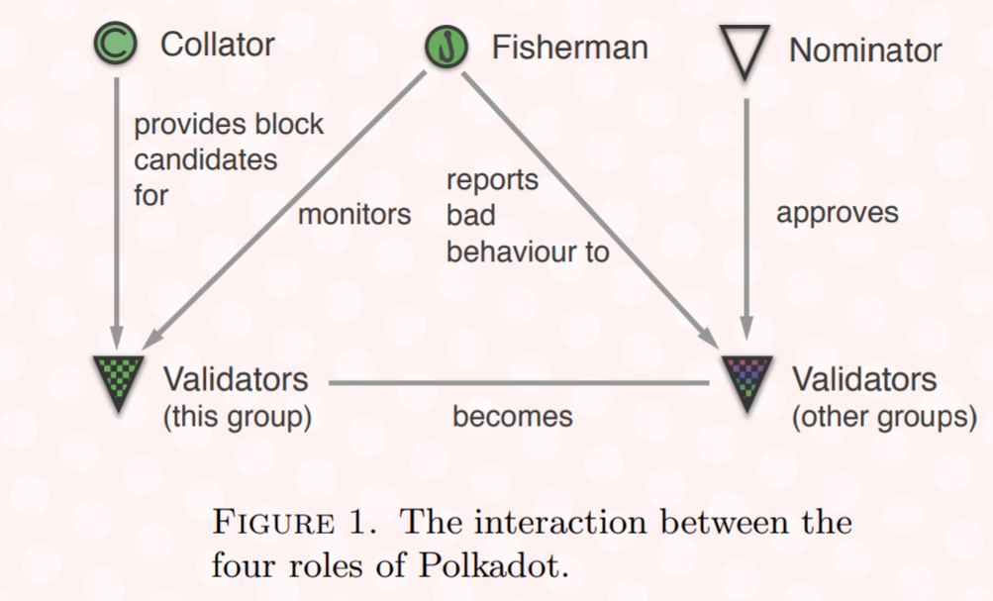
Polkadot ‧ Cosmos
Four basic roles
Solutions

Slide 15
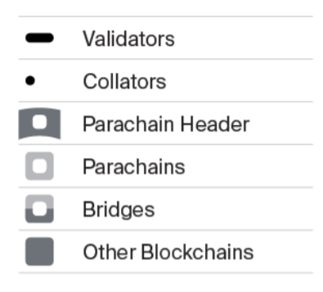
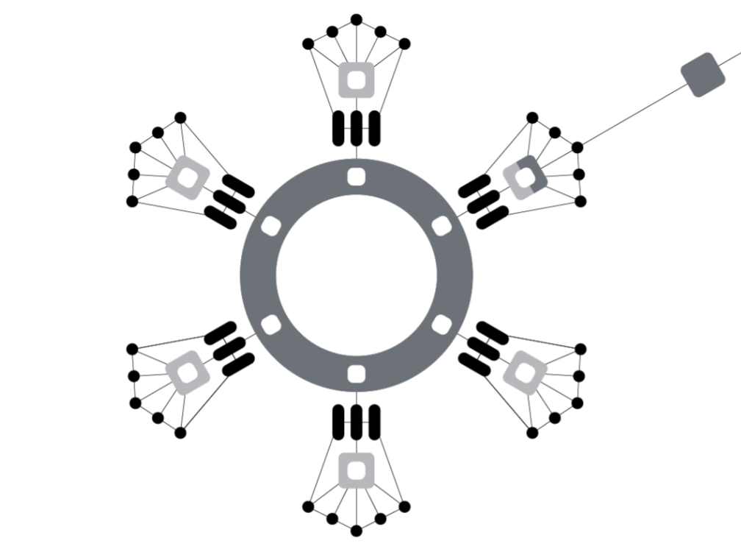
Polkadot ‧ Cosmos
Hybrid Consensus (GRANDPA/BABE)
Solutions

Slide 16
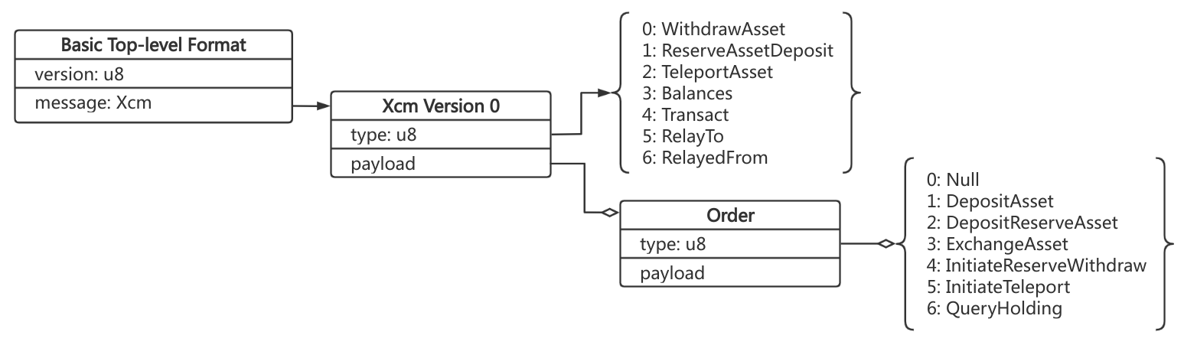
Polkadot ‧ Cosmos
Cross-chain Message Passing (XCMP)
Horizontal Relay-routed Message Passing (HRMP)
Vertical Message Passing (VMP)
Solutions

Slide 17
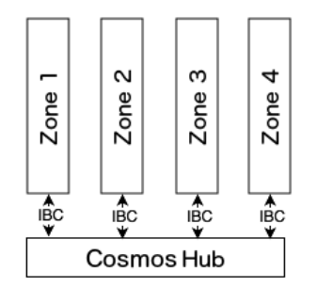
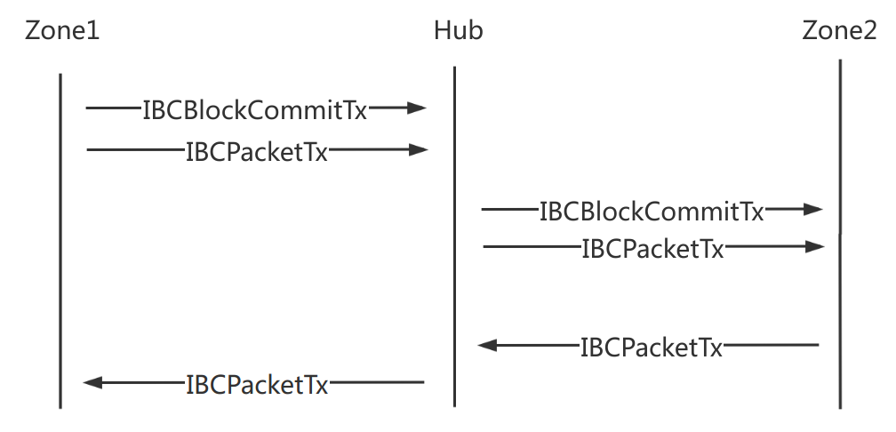
Polkadot ‧ Cosmos
Inter-blockchain Communication (IBC)
IBCBlockCommitTx
IBCPacketTx
Cosmos Hub : Proof of Stake
Zones : Tendermint BFT
Solutions

Slide 18
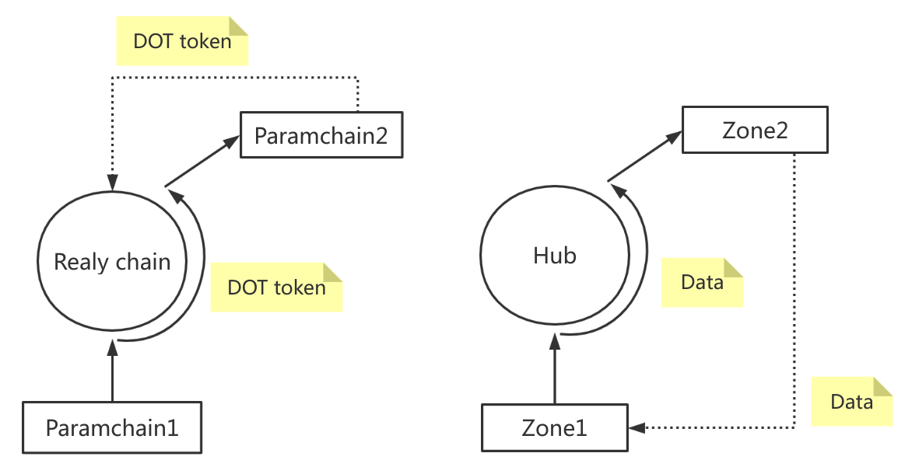
Polkadot vs Cosmos
Solutions

Slide 19
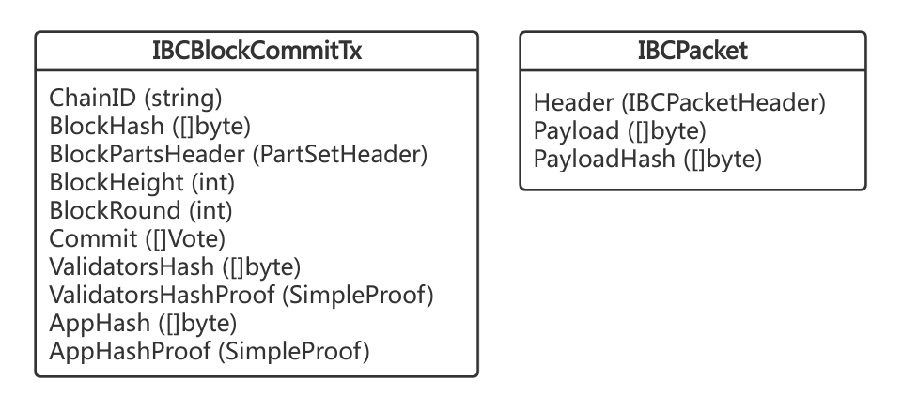
Polkadot ‧ Cosmos
Transaction type:
SendTx
BondTx
UnbondTx
ReportHackTx
SlashTx
BurnAtomTx
ProposalCreateTx
ProposalVoteTx
Solutions

Slide 20
Plan
Out plan to implement an inter-blockchain.

Slide 21
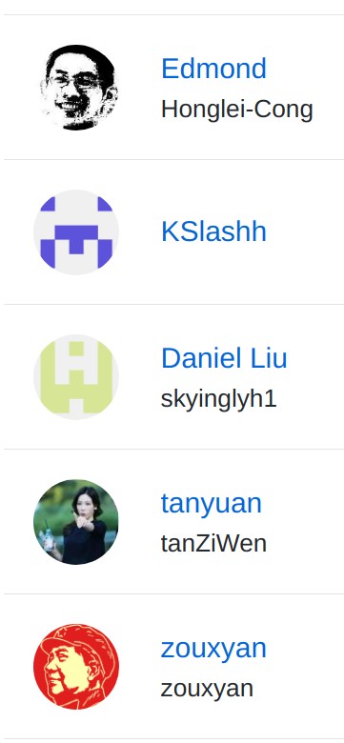
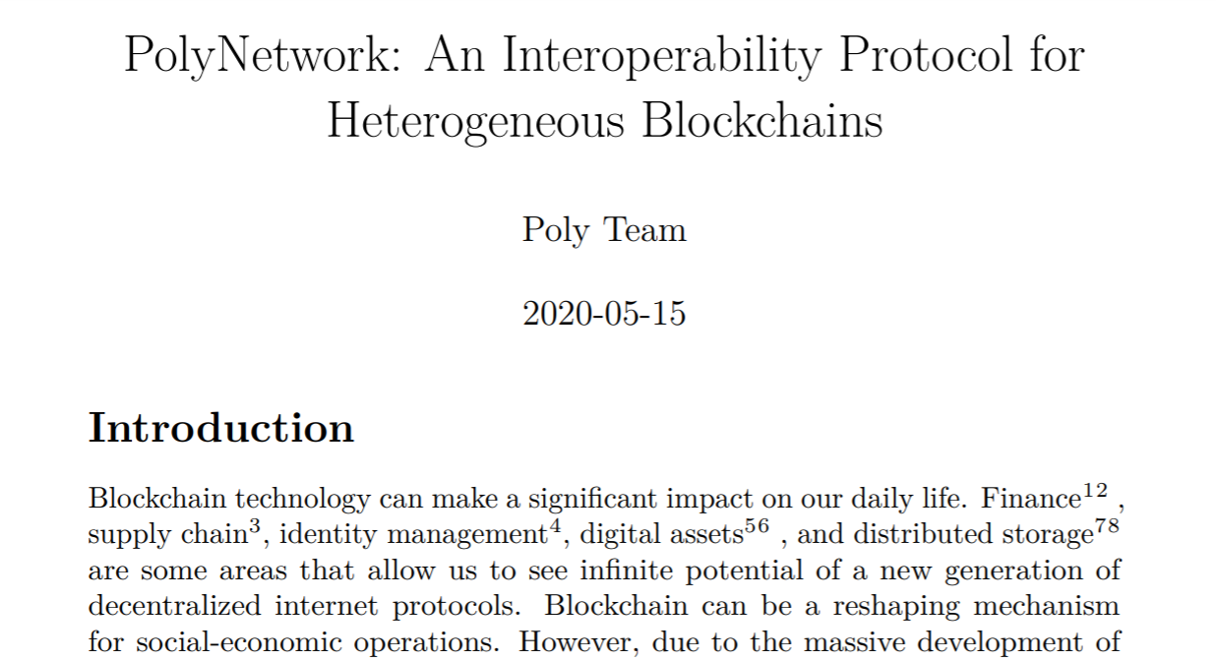
About PolyNetwork

Slide 22
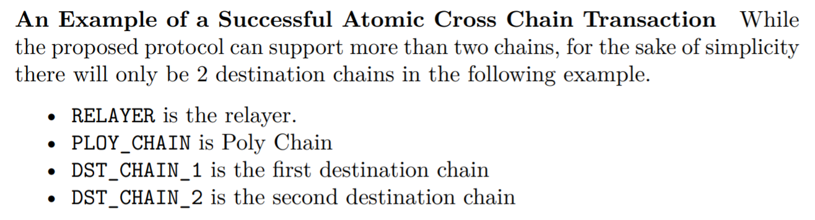
Advantage
Wide range of support and strong versatility
Easy to join in
Support atomic transaction
Support cross-chain of arbitrary information
Security Enhancement
Eco Friendly

Slide 23
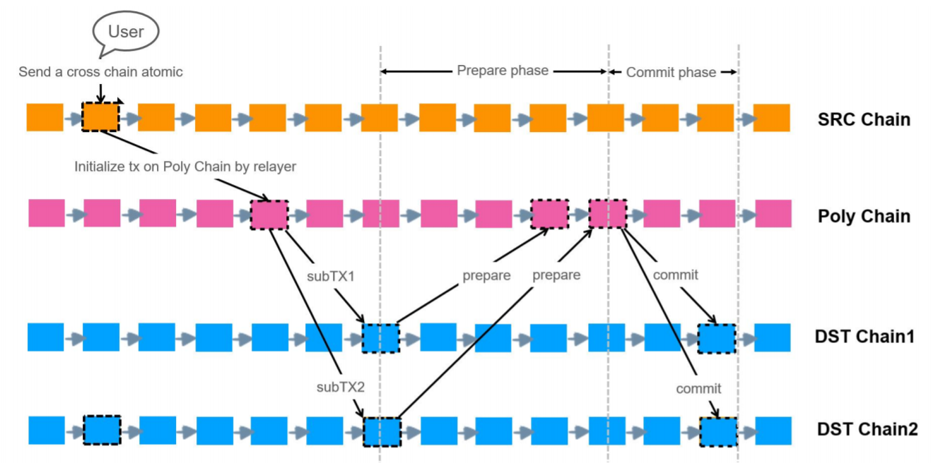

Slide 24
Make results with the least effort
The biggest unanswerable problem
What is interoperability for?
Keep it simple enough:
HTTP
JSON
{ type, payload}
......
The basic function we should provide at least:
Register / Logout
Cross-chain message routing
Asynchronous notification
......

Slide 25
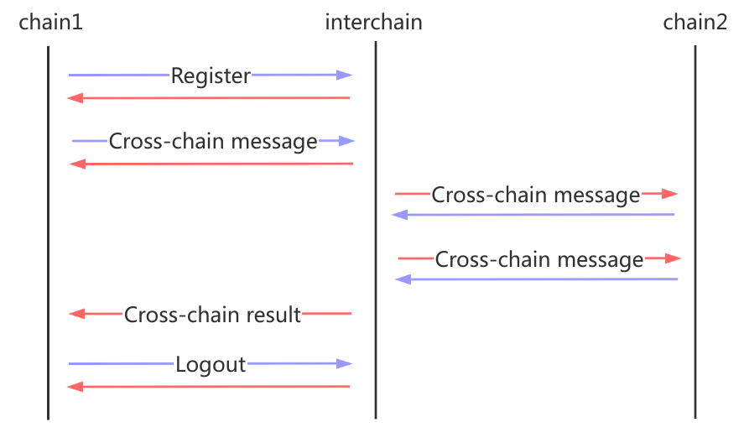
Minimal Protocal
For parachains:
Send type: 5
Receive type: 6
......

Slide 26
Thanks!
Any questions?
You can find me at
dev.wangyu@gmail.com

